Slide 1
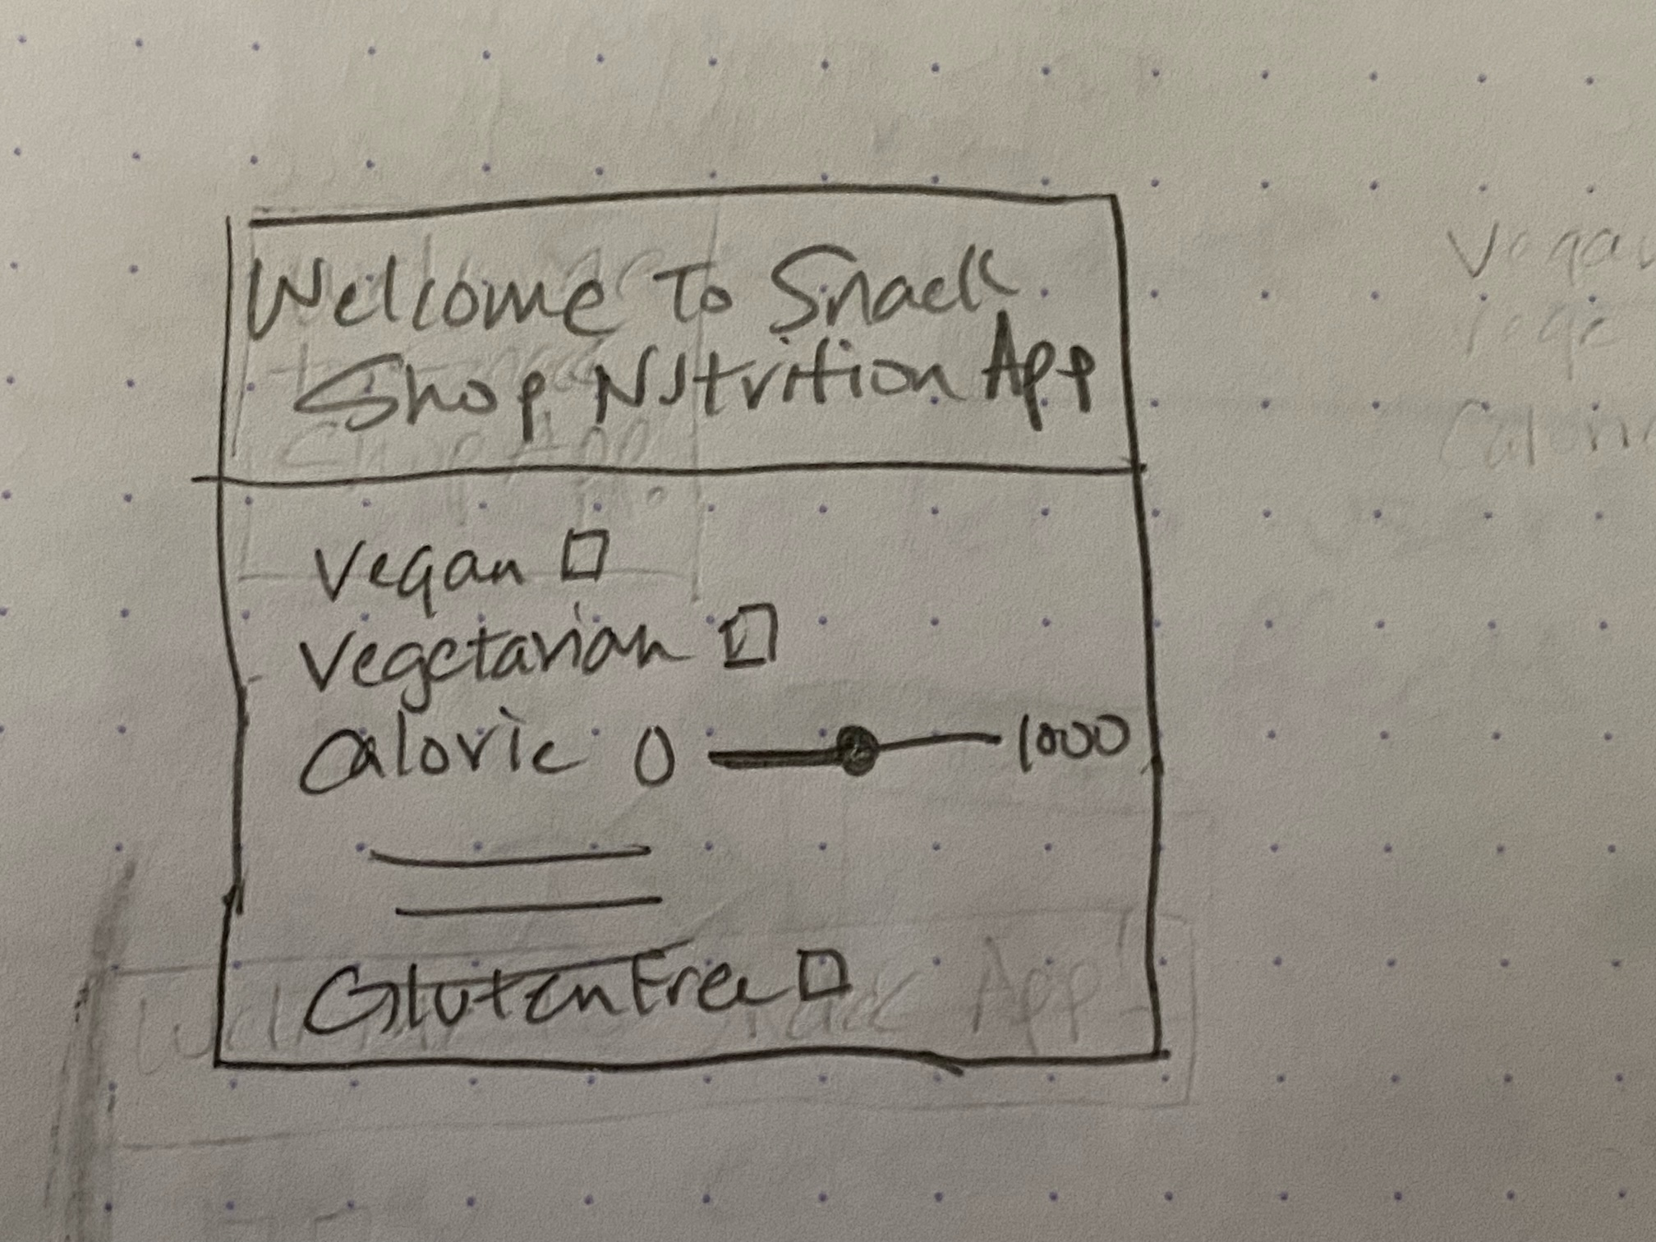
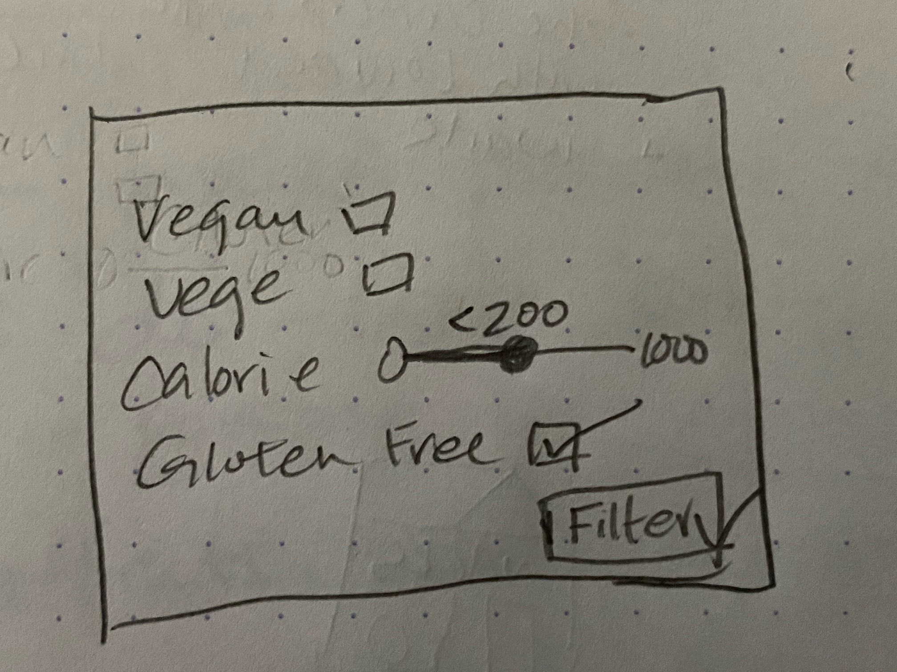
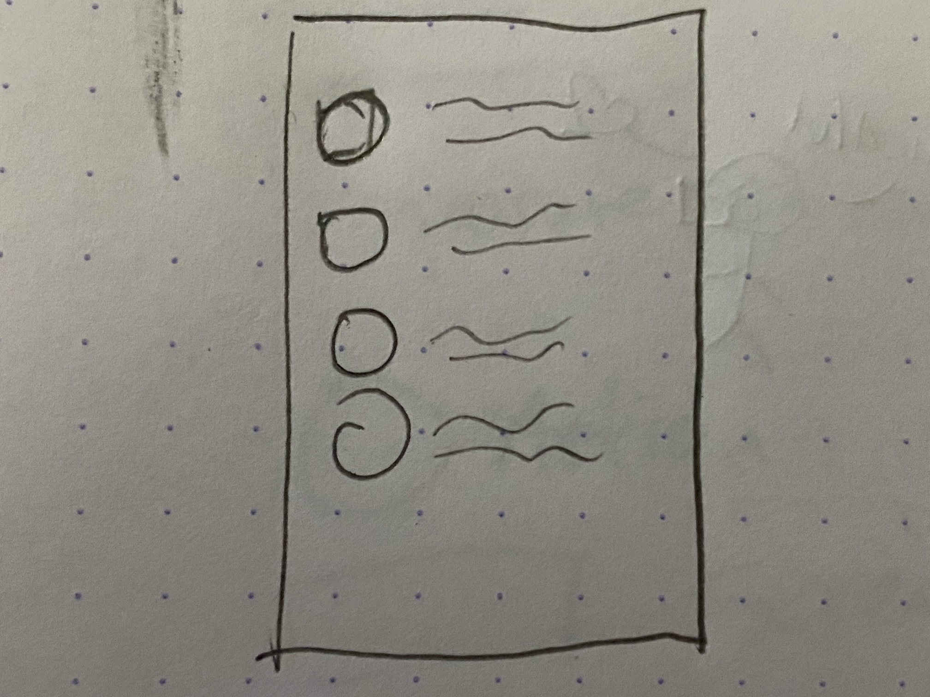
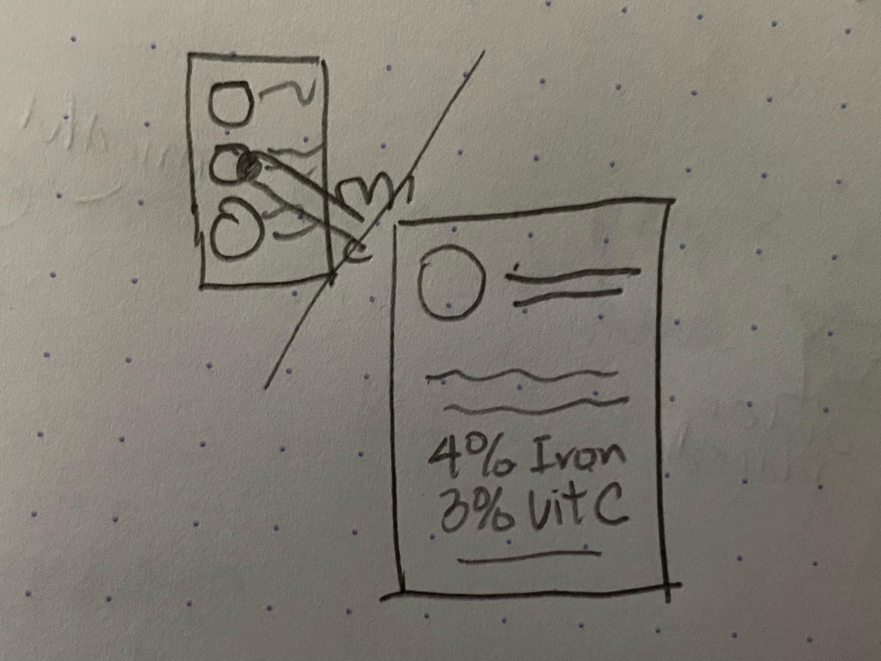
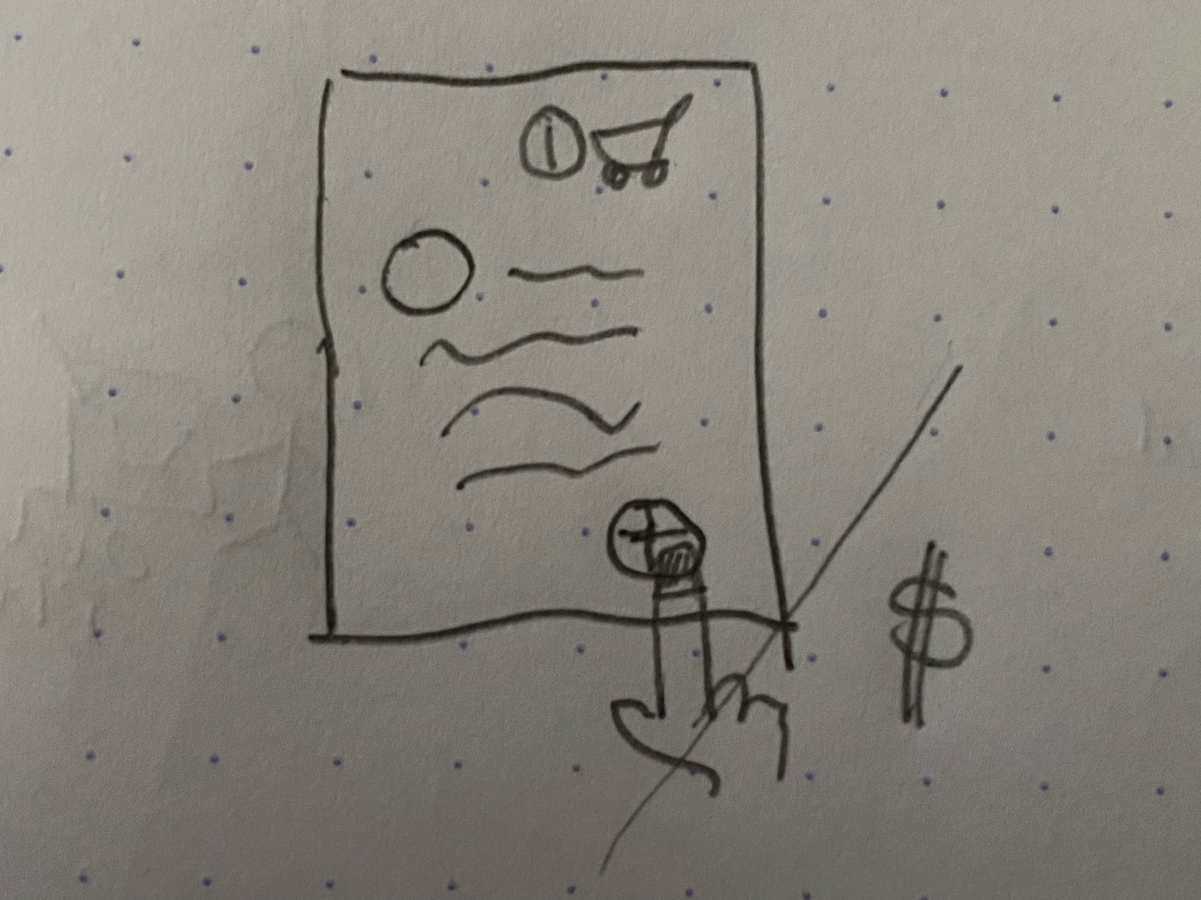
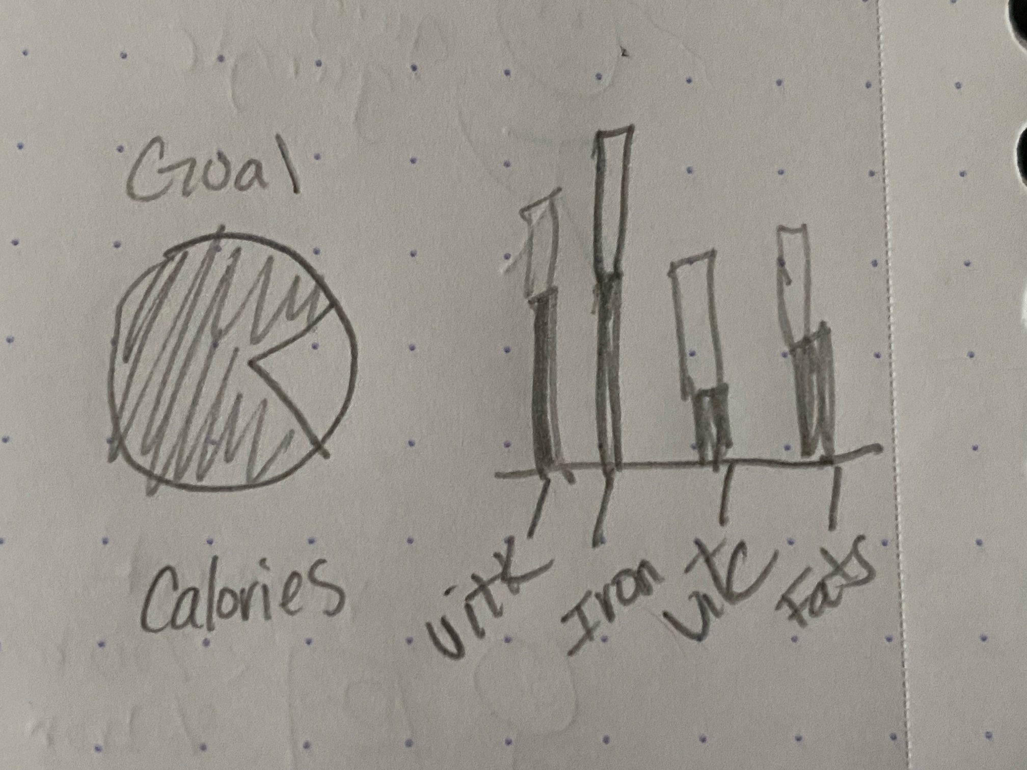
UX Design Storyboard
Scenario: Use theme park nutrition app to mindfully order snacks – close up
Anika Opens Nutrition App and is Greeted and provided Filters for Snacks
She selects her desired filters for the types of snacks she would like to eat.
She then browses through the list of apps that meets her selection criteria.
She clicks into a snack she would like to review more in detail and is given micro nutrient information.
She adds the snack to her cart and checks out and pays for the snacks.
She is shown a dashboard with her food consumption details like total calories, and various micronutrient intake summaries.

